Slide 1
Food Venues in Canada
Mehul Prajapati
IBM Certification

Slide 2

Background
The Food Industry is one biggest industries in the world
Canada is known for many things, but in this presentation, we are going to understand food industry Of Canada.
We are going to focus on three city: Toronto, Montreal, and Calgary

Slide 3
Data Sources
Canadian Postal Codes
Four Square Venues
261 Forward Sortation Areas (FSA) (e.g. H1M)
Scraped from Wikipedia html tables
5,798 Venues
Food Categories
Geo coordinates (lat, lng)
Search Endpoint Called and data extracted from JSON

Slide 4
Venue Data Sample
City | Place | Place Latitude | Place Longitude | Name | Latitude | Longitude | Category | Category Id
Toronto, Ontario | M1B | 43.8113 | -79.193 | Meena's Fine Foods | 43.804476 | -79.199753 | Indian Restaurant | 4bf58dd8d48988d10f941735
Toronto, Ontario | M1B | 43.8113 | -79.193 | Wendy’s | 43.807448 | -79.199056 | Fast Food Restaurant | 4bf58dd8d48988d16e941735
Toronto, Ontario | M1B | 43.8113 | -79.193 | Twiga Snack Bar | 43.819914 | -79.186483 | African Restaurant | 4bf58dd8d48988d1c8941735
Toronto, Ontario | M1B | 43.8113 | -79.193 | Pizza Pizza | 43.819633 | -79.184681 | Pizza Place | 4bf58dd8d48988d1ca941735

Slide 5
Method Of Collecting DATA
Primary Category is food
Collecting the Data by K-Means

Slide 6
Results of Cluster
Cluster | Calgary, Alberta | Montreal, Quebec | Toronto, Ontario | 1st Most Frequent | 2nd Most Frequent | 3rd Most Frequent | 4th Most Frequent | 5th Most Frequent
0 | 5 | 14 | 6 | Categories_Asian Restaurant | Categories_Café | Categories_Restaurant | Categories_Fast Food Restaurant | Categories_Dessert Shop
1 | 0 | 2 | 0 | Categories_Asian Restaurant | Categories_Fast Food Restaurant | Categories_Sandwich Place | Categories_Pizza Place | Categories_Café
2 | 5 | 18 | 11 | Categories_Asian Restaurant | Categories_Pizza Place | Categories_Café | Categories_Restaurant | Categories_Bakery
3 | 0 | 0 | 3 | Categories_Asian Restaurant | Categories_Korean Restaurant | Categories_Café | Categories_Dessert Shop | Categories_Italian Restaurant
4 | 15 | 77 | 79 | Categories_Asian Restaurant | Categories_Café | Categories_Pizza Place | Categories_Restaurant | Categories_Dessert Shop

Slide 7
Cluster By Cites
City | Cluster0 | Cluster1 | Cluster2 | Cluster3 | Cluster4 | 1st Most Frequent | 2nd Most Frequent | 3rd Most Frequent | 4th Most Frequent | 5th Most Frequent
Calgary, Alberta | 5 | 0 | 5 | 0 | 15 | Categories_Asian Restaurant | Categories_Pizza Place | Categories_Dessert Shop | Categories_Fast Food Restaurant | Categories_Sandwich Place
Montreal, Quebec | 14 | 2 | 18 | 0 | 77 | Categories_Asian Restaurant | Categories_Café | Categories_Restaurant | Categories_Dessert Shop | Categories_Pizza Place
Toronto, Ontario | 6 | 0 | 11 | 3 | 79 | Categories_Asian Restaurant | Categories_Pizza Place | Categories_Restaurant | Categories_Café | Categories_Fast Food Restaurant

Slide 8
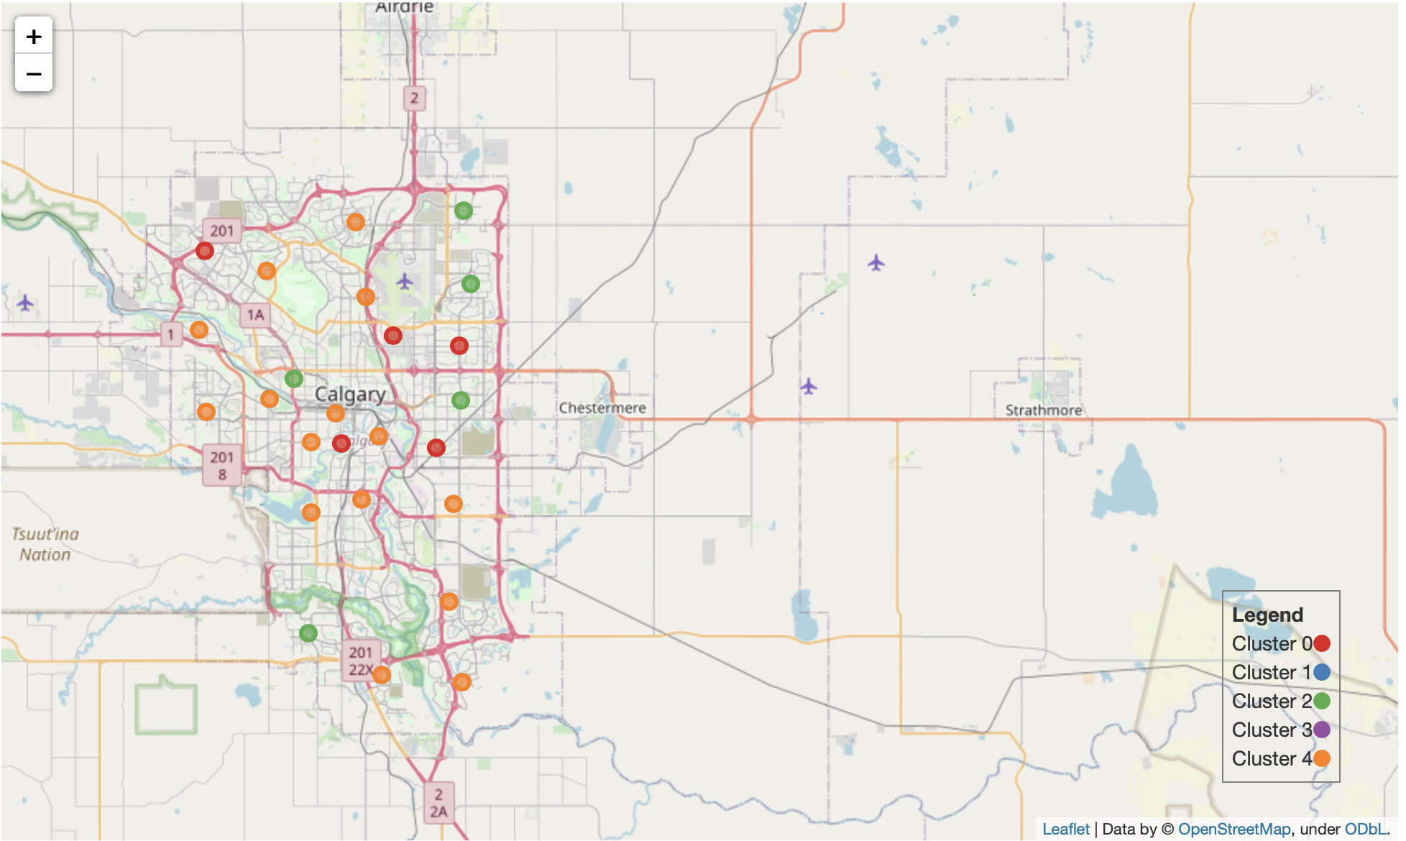
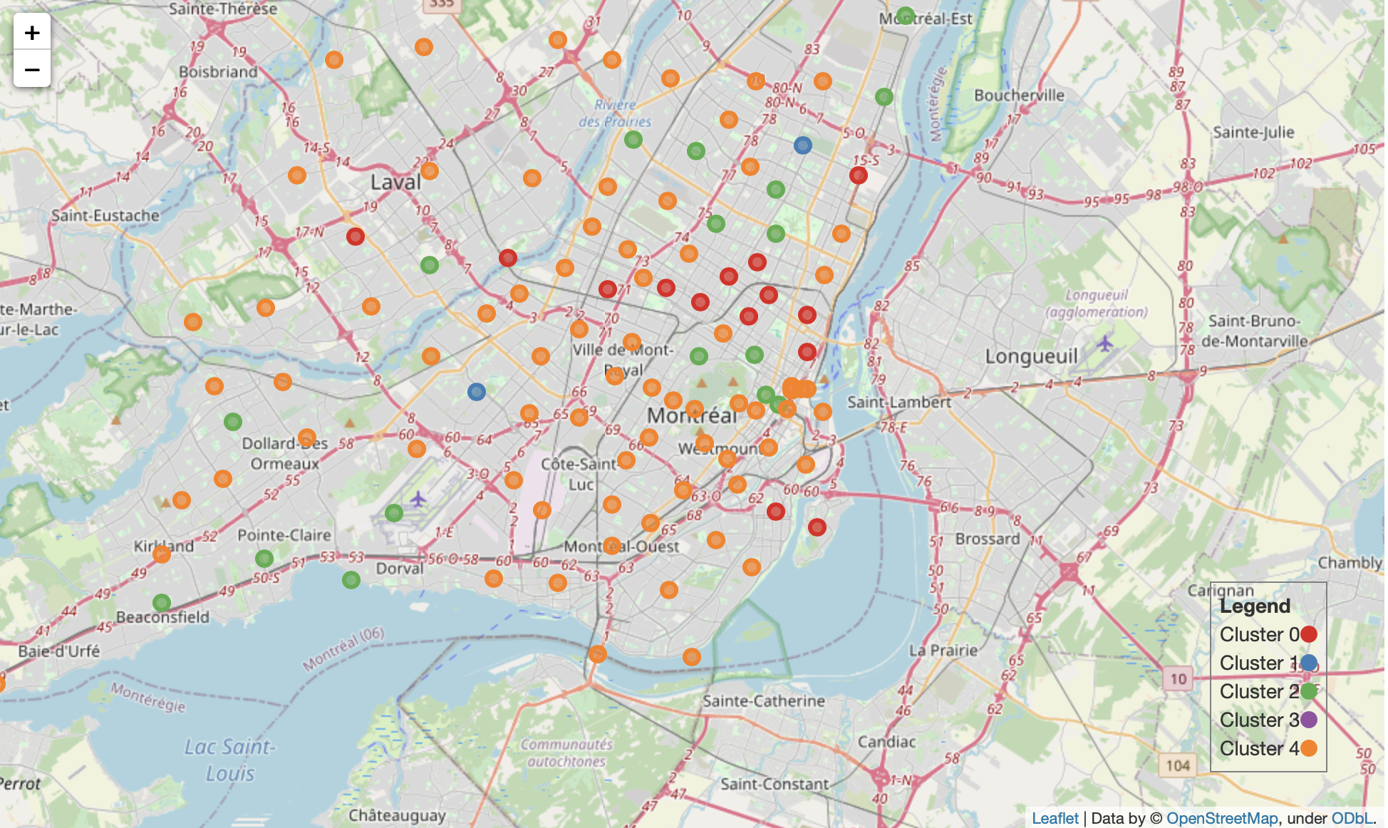
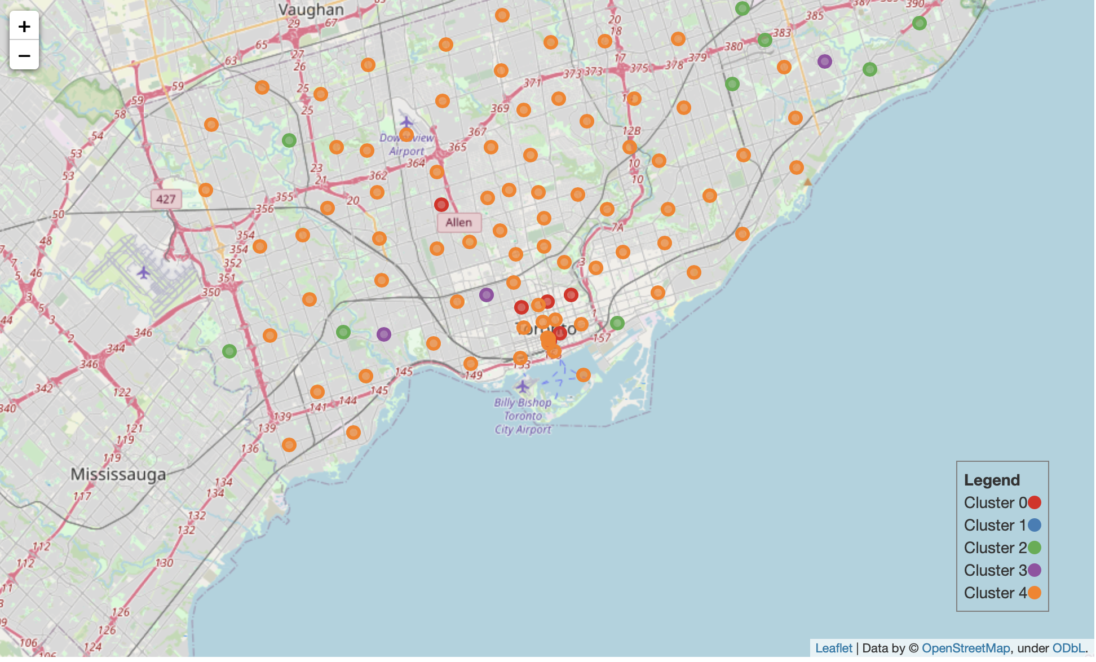
Map Perspective
Calgary, Alberta
Montreal, Quebec
Toronto, Ontario

Slide 9
Understanding the Data
We’ve learned that Canadian like Asian Restaurant
The second most visited food places are café in Montreal and as for the other two cites are pizza places.
Least visited places are Sandwich shop

Slide 10
Conclusion
One of the Best Restaurant to open in Canada is an Asian restaurant.
It also seem to be that each city has it own diversity of people, but there are high frequency of Coffee Shops, Cafes, Asian Restaurants, Fast Food and Pizza Places in each city.
Calgary: Vietnamese
Montreal: Dessert Shop
Toronto: Japanese

